Slide 1
DATABASE MANAGEMENT SYSTEM
CS23332
EXERCISE 2
MANIPULATING DATA
GANGA GOWRI P
241801070

Slide 2
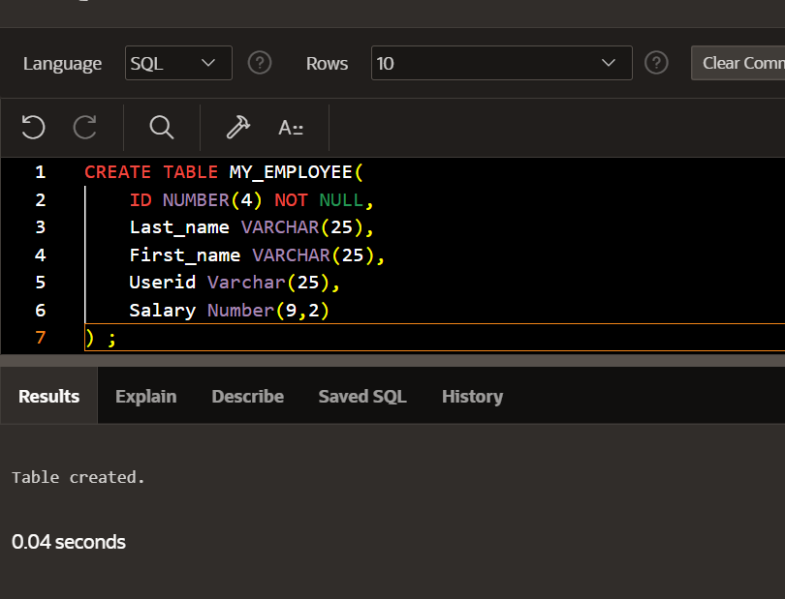
1. Create MY_EMPLOYEE table with the following structure

Slide 3
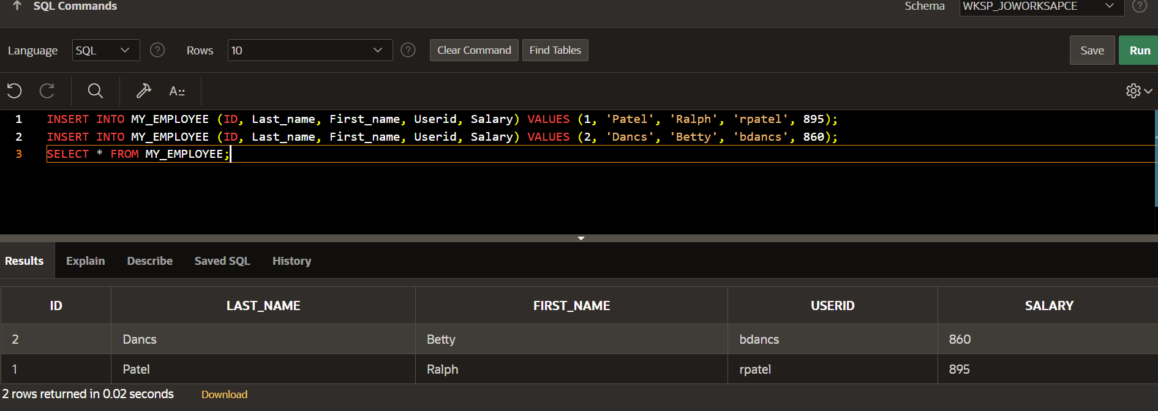
2. Add the first and second rows data to MY_EMPLOYEE table from the following sampledata.
3. Display the table with values.

Slide 4
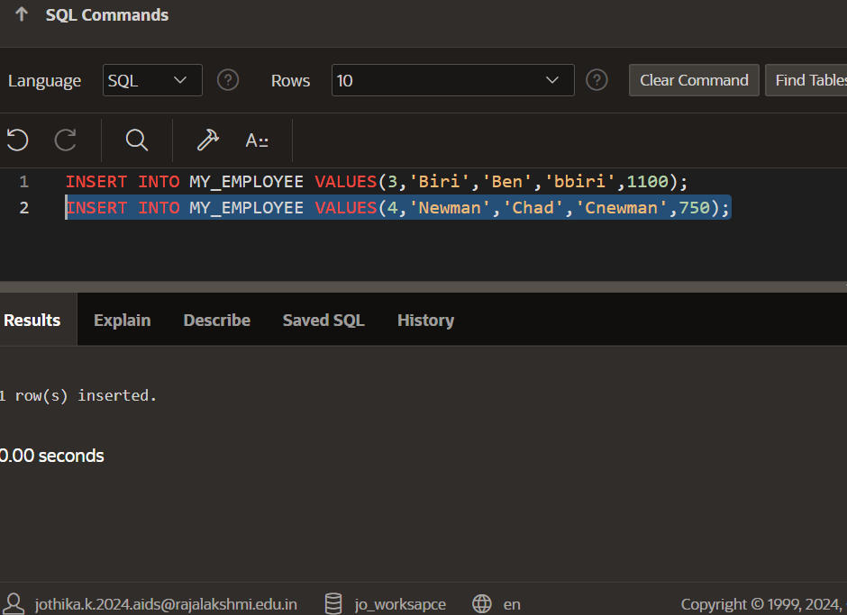
4. Populate the next two rows of data from the sample data. Concatenate the first letter of the first_name with the first seven characters of the last_name to produce Userid.

Slide 5
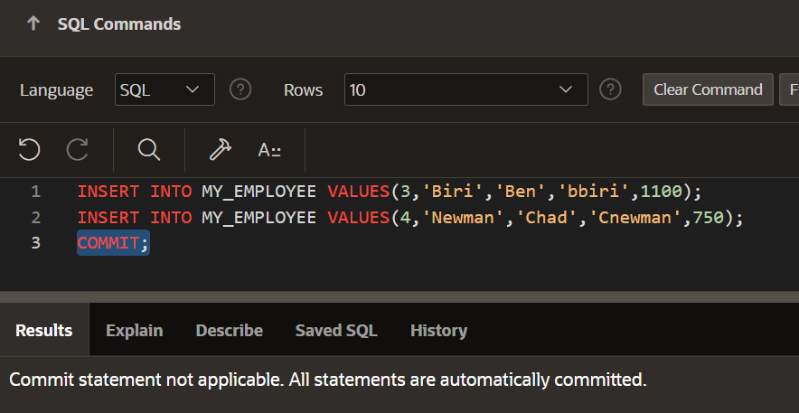
5. Make the data additions permanent.

Slide 6
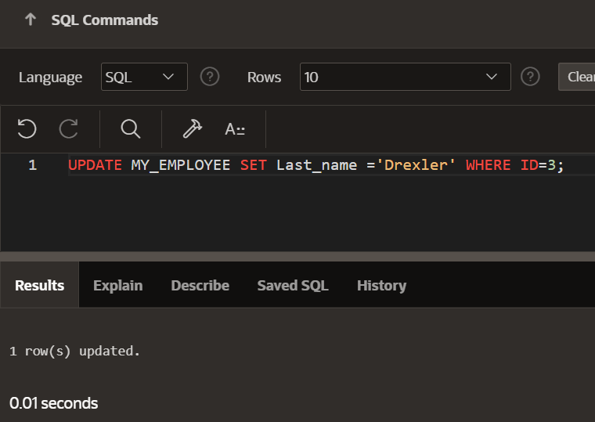
6. Change the last name of employee 3 to Drexler.

Slide 7
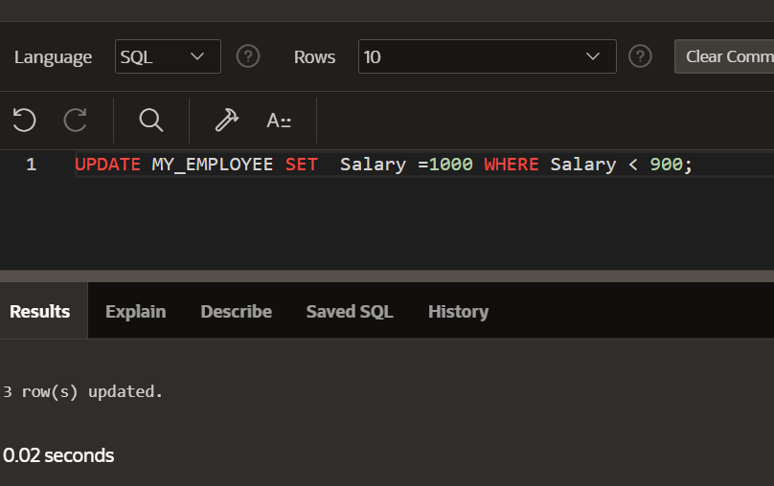
7. Change the salary to 1000 for all the employees with a salary less than 900.

Slide 8
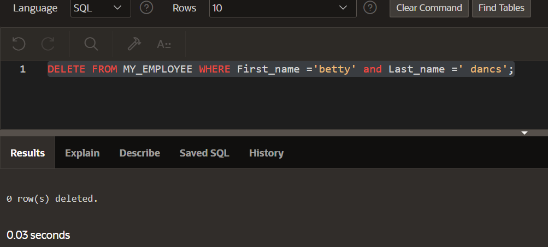
8. Delete Betty dancs from MY _EMPLOYEE table.

Slide 9
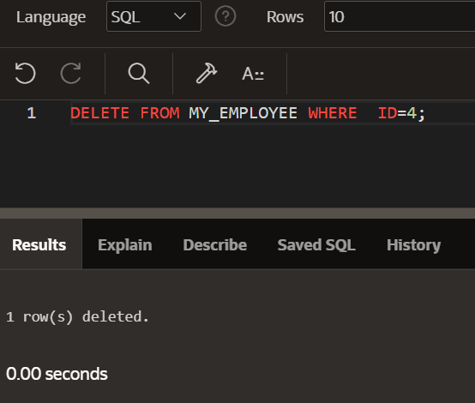
9. Empty the fourth row of the emp table.

